Slide 1

  Chapter Three
  The Network Layer

Slide 2
Outline
  Internetworking,
  Unicast and multicast routing
  IPV4 Addressing [Class full]
  IPV4 Addressing [ Classless- VLSM addressing]
  Network layer protocols
  Introducing IPV6 Addressing

Slide 3
Network Layer (3rd OSI Layer)
Concerned with getting packets from source to destination.
The network layer must know the topology of the subnet and choose appropriate paths through it.
When source and destination are in different networks, the network layer must deal with these differences.
The network layer is responsible for the source-to-destination delivery of a packet, possibly across multiple networks.
Whereas the data link layer oversees the delivery of the packet between two systems on the same network, the network layer ensures that each packet gets from its point of origin to its final destination.
If two systems are connected to the same local network, there is usually no need for a network layer. However, if the two systems are attached to different networks with connecting devices between the networks, there is often a need for the network layer to accomplish source-to-destination delivery.

Slide 4
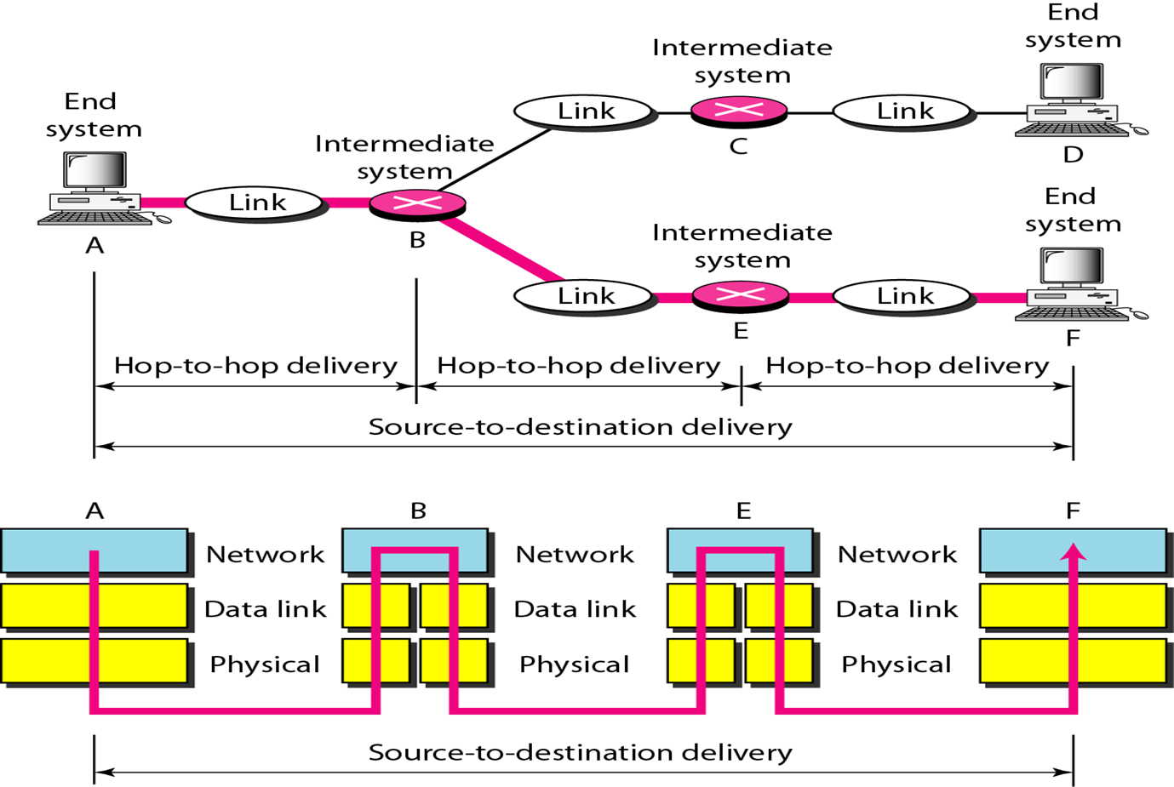
Cntd…

Slide 5
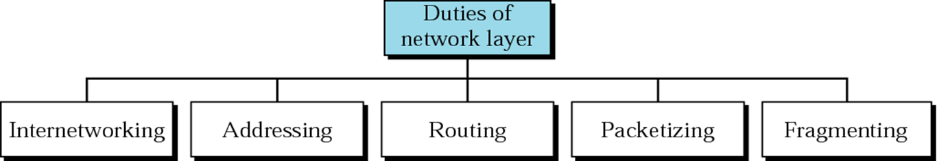

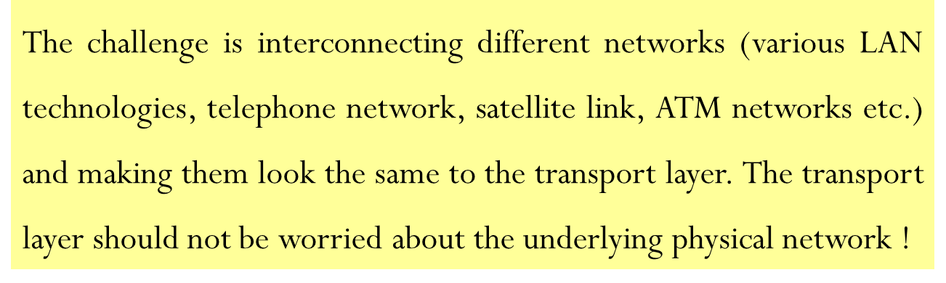
Cntd…

Slide 6
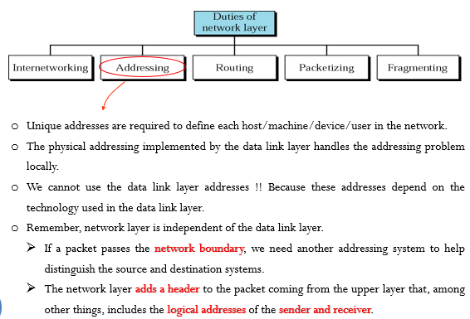
Cntd…

Slide 7
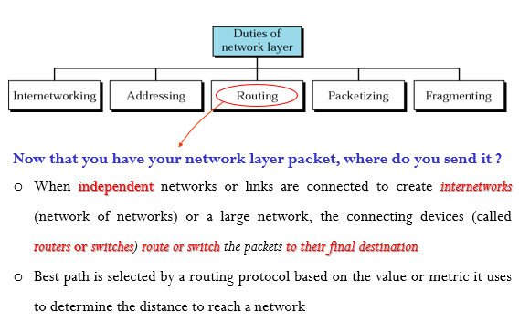
Cntd…

Slide 8
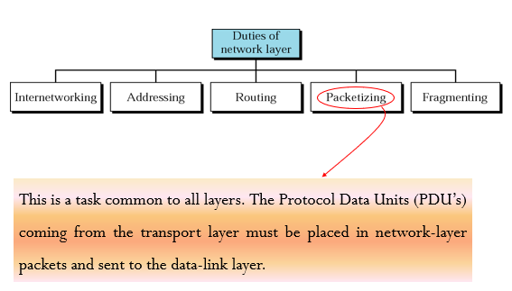
Cntd…

Slide 9
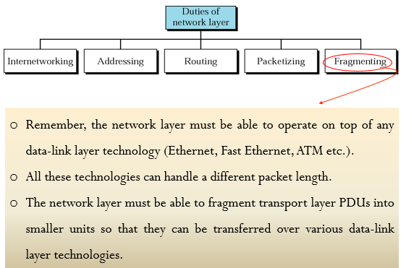
Cntd…

Slide 10
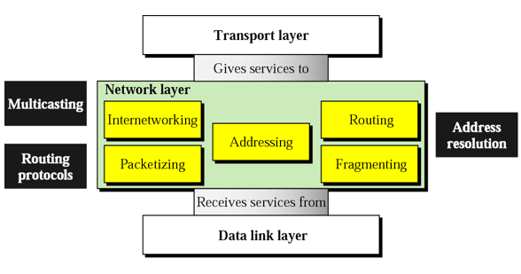
Position of network layer

Slide 11
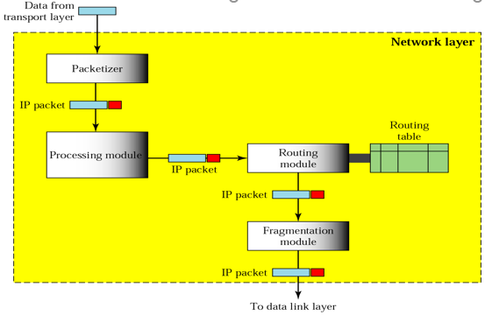
Network layer at the source

Slide 12
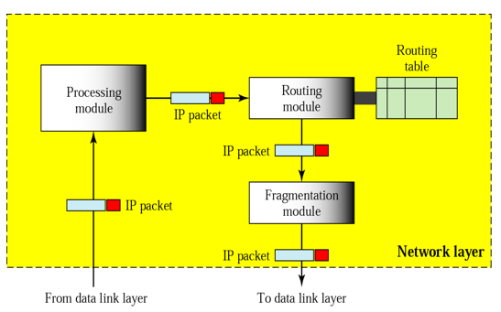
Network layer at the Router

Slide 13
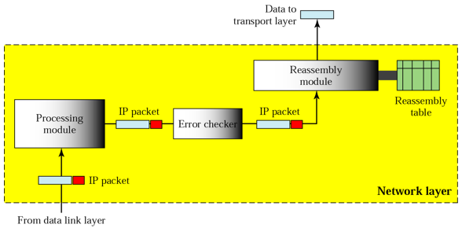
Network layer at the Destination

Slide 14
Network Layer Protocols
  IPv4 was not designed with this feature in mind, although mobility extensions exist.
  IPv6 has a better designed solution.
  Network layer protocols include: IPv4/IPv6, DVMRP (Distance Vector Multicast Routing Protocol), ICMP(Internet Control Message Protocol), IGMP(Internet Group Multicast Protocol), PIM-SM( Protocol Independent Multicast Sparse Mode), PIM-DM(Protocol Independent Multicast Dense Mode), IPsec(Internet Protocol Security), IPX(Internetwork Packet Exchange), RIP(Routing Information Protocol), Interior Gateway routing protocol(IGRP), Enhanced IGRP(EIGRP), Open Shortest Path First(OSP), DDP(Datagram Delivery Protocol), BGP(Border Gateway Protocol),

Slide 15
Routing Basics
The network layer of the OSI model provides routing functions and establishes the route between the source and destination through intermediary nodes(routers).
Routing is one of the fundamental aspects of networking. The ability of routers to learn possible routes (rather than make you manually configure and constantly update the routes) is one of the primary reasons that ARPANET which originally connected seven sites, scaled into the modern Internet in only a few short years.
A router is connected to at least two networks, and forwards data packets from a network to another.
When it receives an incoming packet, it decides the next router (hop) to which the packet should be forwarded towards its destination.
A routing table maintains the best routes to various network destinations.

Slide 16
Cont…
The construction of routing tables is very important for efficient routing, and any corruption of the table may lead to significant routing problems.
To create and maintain a routing table, a router communicates with other routers using routing protocols.
A routing protocol allows routers to share information about networks and their proximity to each other.
The routing protocol running in a router will learn all available paths to a network (based on the information advertised from different routers), but only determine the best path to be stored in the routing table.
Whenever the topology of a network changes (e.g., a new link is added or removed), the routing protocol will determine another best path (if needed) and update the routing table accordingly for the routing table in the updated topology.

Slide 17
What are the Routing activities?
10.120.2.0
172.16.1.0
Path determination occurs at Layer 3, the network layer.
The path determination function enables a router to evaluate the available paths to a destination and to establish the best path.
Routing services use network topology information when evaluating network paths.
This information can be configured by the network administrator (static routes) or collected through dynamic processes (routing protocols) running in the network.
Routing involves two basic activities:
    determining optimal routing paths and
    transporting packets through a network.
To route, a router needs to know:
    Destination addresses
    Sources it can learn from
    Possible routes
    Best route

Slide 18
Cntd.
Routed networks are often large and complex, and it would be excessively difficult to manage and update network information on all routers all the time.
Several algorithms have been developed to help address these difficulties.
These algorithms allow the routers to learn about the network and then make decisions based on that information.
To learn paths (or routes) through a network, and make decisions on where to send packets, a router use:
    Destination address - Typically the Internet Protocol (IP) address of the data’s (packet) destination.
    Source address - Where the information came from (typically an IP address).
    Possible routes - Routes that can get information from its present location or source to some other location (the destination or closest known point).
    Best route - The best path to the intended destination. (“Best” can mean many things.)
    Status of routes - The current state of routes, which routers track to ensure timely delivery of information.

Slide 19
What Exactly Does “Best” Mean?
Routers often make decisions about the best possible path to get information from a source to a destination.
  “Best,” however, is loosely defined, and it depends on what is valued by the network.
  These measurements of value are referred to as metrics.
Several metrics are listed here:
  Hop count - Number of times a packet goes through a router.
  Delay time - Time required to reach the destination.
  Reliability - Bit-error rate of each network link.
  Maximum transmission unit (MTU) - Maximum message length (or packet size) allowed on the path.
  Cost - Usually some combination of other metrics.

Slide 20
Which Router/ Routing to Use?
To forward network traffic to the proper locations, the routers on your network must have the correct entries in their routing tables.
To do so routers will use either static or dynamic routing techniques.
With static routing, network administrators must manually create and modify the routing table entries.
Dynamic routing uses a specialized routing protocol to update the table entries automatically.

Slide 21
Static Routes
Static routes use a programmed route that a network administrator enters into the router.
  A network administrator configures information about remote networks manually
Benefits
  No overhead on the router CPU
  No bandwidth usage between routers
  Adds security
Disadvantage
  Administrator must really understand the internetwork
  If a network is added to the internetwork, the administrator has to add a route to it on all routers
  Not feasible in large networks

Slide 22
Dynamic Routing
Dynamic route uses a route that a routing protocol adjusts automatically for topology or/and traffic changes
  When routers use dynamic routing, this information is learned from other routers
Benefits
  scalability and adaptability
  can grow more quickly and larger
  adapt to changes in the network topology
Disadvantage
  complex structure
  Adds overhead on the router CPU
  Routers uses bandwidth to send routing table updates
  Security issue

Slide 23
Overview of Internet Routing
The Internet comprises a large number of interconnected heterogeneous routing domains called autonomous system (AS).
AS is essentially a collection of IP networks and routers under the same administration that share a common routing strategy.
  An Internet service provider (ISP) is the typical example of an AS.
For the outside world, an AS is regarded as a single routing entity.
Each AS must has a 16-bit AS number, which is unique and assigned by a regional Internet registry such as the American Registry of Internet Numbers (http://www.arin.net).
Some routing protocols require the AS number to make routing decisions.

Slide 24
Interior Vs Exterior Routing Protocols
The routing protocols used within an AS are called interior gateway protocols (IGPs), and the ones used between ASs are called exterior gateway protocols (EGPs).
Their main difference is that IGPs provide information on reachable interior destinations to the outside work, whereas, inversely, EGPs provide information on reachable exterior destinations to the interior routers.
EGPs are typically used between ISPs.
Another difference between them is the route determination.
IGPs choose the best path through the network based on some metrics such as distance, delay, or bandwidth.
Therefore, how the metrics are used is an important design issue for IGPs.
EGPs choose routes commonly according to a routing policy.

Slide 25
Difference between IGP & EGP
IGP (Interior Gateway Protocol) :-
  Within a single autonomous system
  Single network administration
  Unique routing policy
  Make best use of network resource
IGP’s fall into two categories:
  Distance Vector Protocols
      Routing Information Protocol (RIP V₁ and RIP V₂, RIP_{ng})
      Interior Gateway Routing Protocol (IGRP)
      Enhanced Interior Gateway Routing Protocol (EIGRP)
  Link State Protocols
      Open Shortest Path First (OSPF)
      Intermediate System to Intermediate System (IS-IS)

Slide 26
Cntd…
EGP (Exterior Gateway Protocol ) :-
Among different autonomous systems
Independent administrative entities
Communication between independent network infrastructures
EGP is commonly used between hosts on the Internet to exchange routing table information.
Examples of an EGP:
  Border Gateway Protocol (BGP)
  Exterior Gateway Protocol (Replaced by BGP)

Slide 27
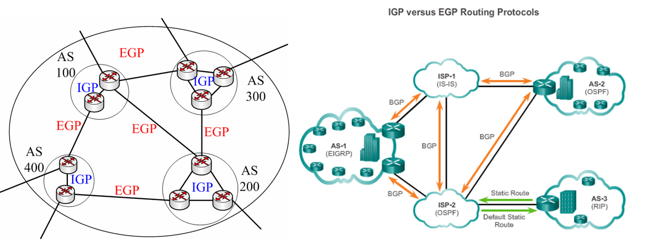
Cntd…
Fig. The Internet comprises a large number of autonomous systems

Slide 28
Classful Vs Classless Routing Protocols
A. Classful routing protocols do not include the subnet mask with the route advertisement.
Within the same network, consistency of the subnet masks is assumed.
Summary routes are exchanged between foreign networks.
  E.g., of classful routing protocols: RIP V1, IGRP
  B. Classless routing protocols include the subnet mask with the route advertisement.
  Classless routing protocols support variable-length subnet masking (VLSM) and subnetting.
  E.g., of classless routing protocols: RIP V2, EIGRP, OSPF, IS-IS

Slide 29
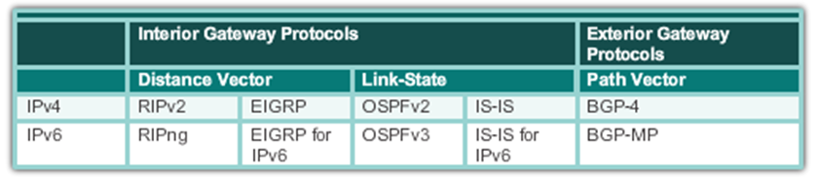
Classifications of Routing Protocols
Different routing protocols use different algorithms and approaches to gather and disseminate routing information about their area.
Routing protocols are classified into the following categories:

Slide 30
Cntd…
Distance Vector
Idea:- The routers using the distance vector routing protocol determine the direction and distance to any link in an internetwork.
  They have no knowledge about instant routers and how they interconnect.
  That is, they do not have the knowledge of the network topology.
When there is more than one path available to a destination, to determine which one is the “best”, typically based on hop count, an algorithm has to be used.
Distance vector routing protocols commonly use the Bellman-Ford algorithm to perform the best path determination.

Slide 31
Advantage & Disadvantage of Distance Vector Protocol
There are two Distance Vector Protocol, Both uses different metric
  RIP uses Hop count as metric
  IGRP and EIGRP use composite Metrics such as bandwidth, Delay, Load, Reliability and MTU
Advantage:- They are simple and efficient in all networks.
Disadvantage:- It does not scale well and has poor convergence properties
192.168.20.1
192.168.10.1

Slide 32
cntd…
Link-State Routing Protocol
Idea:- The routers using the link-state routing algorithm have the knowledge of the complete topology of an internetwork, that is, have the knowledge of distant routers and how they interconnect.
  With this knowledge, each router is able to independently determine the best (shortest) path from itself to every other router.
  The best path calculation is typically based on the Dijkstra algorithm.
  Therefore, the link-state routing algorithm is also known as the Dijkstra algorithm or as the Shortest Path First (SPF) algorithm.

Slide 33
Advantage & Disadvantage of Link-state Protocol
Advantage:-
  Introducing lower network overhead
  The link-state database size can be minimized with careful network design.
  Fast convergence:- changes are reported immediately by the source affected.
  Routers know the topology
  Link-state packets are sequenced and aged (old).
Disadvantage:-
  link-state protocols are more complex (to learn, to implement and to configure) and resource(memory & CPU) intensive.
  Requires very strict network design.
  Initial flooding can impede network performance

Slide 34
Distance Vector Vs. Link State Routing Protocols
Distance Vector
Updates frequently
Each router is "aware" of only its immediate neighbors
Slow convergence
Prone to routing loops
Easy to configure
Fewer router resources required
Updates require more bandwidth
Does not "understand" the topology of the network
Link State
Updates are event triggered
Each router is "aware" of all other routers in the "area"
Fast convergence
Less subject to routing loops
More difficult to configure
More router resource intensive
Updates require less bandwidth
Has detailed knowledge of distant networks and routers

Slide 35
Cntd…
Path Vector Routing Protocol
  Idea:- The main characteristic of path vector protocols is that a path of autonomous system numbers between the source and destination (AS path) is maintained to detect loops.
  Are a class of distance vector protocols -> they also have no knowledge about instant routers and how they interconnect in the network.
  It uses the Bellman-Ford algorithm when there is more than one path available to a destination.
  The operation is similar to that of distance vector protocols.
  Each router advertises its local BGP routing table to its neighbors.
  As routers relay the advertisements, they add new routes to its own local routing table based on the contents of the advertisement.
  Besides, they add their own AS number to the AS path before sending out the advertisement.

Slide 36
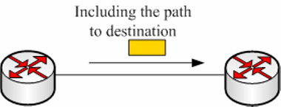
Advantage & Disadvantage of Link-state Protocol
Advantage:- path information can be used to enable policy routing
Disadvantage:- policy routing could introduce a more complex configuration.
Fig. Path Vector Protocol: It maintains the path of autonomous systems that are traversed in order to reach the destination system.

Slide 37
Popular Routing Protocols
  A routing protocol is a protocol that specifies how routers communicate with each other.
  It disseminating information that enables them to select routes between any two nodes on a computer network
  The choice of the route being done by routing algorithms.
  Each router has a priori knowledge only of networks attached to it directly.
  A routing protocol shares this information first among immediate neighbors, and then throughout the network.
    This way, routers gain knowledge of the topology of the network.
  The term routing protocol may refer specifically to one operating at layer three of the OSI model, which similarly disseminates topology information between routers.

Slide 38
Routing with RIP
  The Routing Information Protocol (RIP) is a simple and true distance vector routing protocol, and the basic idea is that each router advertises the next hop and hop count for each destination it can reach to its directly connected neighbors.
    It sends the complete routing table out to all active interfaces every 30 seconds.
    RIP prevents routing loops by implementing a limit on the number of hops allowed in a path from the source to a destination.
    The maximum (distance) number of hops allowed for RIP is 15.
    Uses Bellman-ford algorithm
    Works well in small networks, but it’s inefficient on large networks.

Slide 39
Cntd…
    RIP comes with three versions:
      RIP version 1 uses only classful routing, which means that all devices in the network must use the same subnet mask
      RIP version 2 does send subnet mask information with the route updates. This is called classless routing.
      RIP next generation: is the newest version of RIP, designed to support IPv6.

Slide 40
Routing with Open Shortest Path First (OSPF)
  The OSPF protocol is a link-state routing protocol.
  unlike RIP, each router within the network has a clear picture of the network topology.
  OSPF is an open standards routing protocol
  This works by using the Dijkstra algorithm (SPF)
  OSPF provides the following features:
    Minimizes routing update traffic
    Allows scalability (e.g. RIP is limited to 15 hops) (Has unlimited hop count)
    It allows multi-level routing hierarchy called area routing.
    Supports VLSM/CIDR(Classless Inter-Domain Routing )
    Allows multi-vendor deployment (open standard)
    Routing updates are flooded when there is a network topology change.
    Uses more complex route selection metrics.

Slide 41
OSPF Tables
  There are three type of tables
  1. Neighbor:- Contain information about the neighbors
    Neighbor is a router which shares a link on same network
  2. Topology:- Contain information about all network and path to reach any network
    All link state advertisement (LSA’s) are entered in to topology table
    When topology changes LSA’s are generated and send new LSA’s
    On topology table an algorithm is run to create a shortest path.
  3. Routing:- Also knows as forwarding database
    Generated when an algorithm is run on the topology database
    Routing table for each router is unique.

Slide 42
Pros and Cons
  OSPF is a more sophisticated routing protocol
    Converges rapidly and accurately
    Can use a metric calculation that effectively selects the "best" route(s) primarily based on bandwidth,
    although an OSPF cost can be administratively assigned
  Use of OSPF requires
    More powerful routing hardware
    More detailed knowledge by the administrator, especially when large multi-area networks are used

Slide 43
Internet Protocol (IP)
  IP is a protocol used for communicating data across a packet-switched internetwork using the Internet Protocol suite, also referred to as TCP/IP.
  IP is the primary protocol in the Internet Layer of the Internet Protocol Suite and has the task of delivering datagrams (packets) from the source host to the destination host based on their addresses.
  For this purpose the IP defines addressing methods and structures for datagram encapsulation.
  The first major version of addressing structure, now referred to as IP Version 4 (IPv4) is still the dominant protocol of the Internet, although the successor, IP Version 6 (IPv6), is being deployed actively worldwide (128 bits).

Slide 44
IPv4 Addresses
  An IPv4 address is a 32-bit address.
  It uniquely and universally defines the connection of a device to the Internet.
  IPv4 addresses are unique and universal.
  They are unique in the sense that each address defines one, and only one, connection to the Internet.
  Two devices on the Internet can never have the same address at the same time.

Slide 45
Address Space
  A protocol such as IPv4 that defines addresses has an address space.
  An address space is the total number of addresses used by the protocol.
  If a protocol uses N bits to define an address, the address space is 2^{N} because each bit can have two different values (0 or 1) and N bits can have 2^{N} values.
  IPv4 uses 32-bit addresses, which means that the address space is 2³² or 4,294,967,296 (more than 4 billion).
  This means that, theoretically, if there were no restrictions, more than 4 billion devices could be connected to the Internet.
  We will see shortly that the actual number is much less because of the restrictions imposed on the addresses.

Slide 46
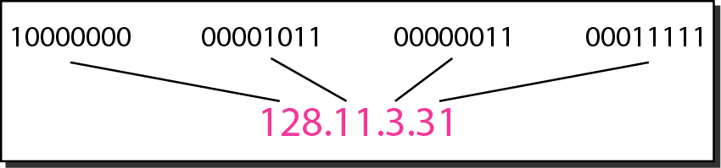
Notation
There are two prevalent notations to show an 1Pv4 address: binary notation and dotted-decimal notation.
Binary Notation: In binary notation, the IPv4 address is displayed as 32 bits. So it is common to hear an IPv4 address referred to as a 32-bit address or a 4-byte address. The following is an example of an IPv4 address in binary notation: 01110101 10010101 00011101 00000010
Dotted-Decimal Notation : To make the IPv4 address more compact and easier to read, Internet addresses are usually written in decimal form with a decimal point (dot) separating the bytes.
The following is the dotted-decimal notation of the above address: 117.149.29.2
Dotted-decimal notation and binary notation for an IPv4 address

Slide 47
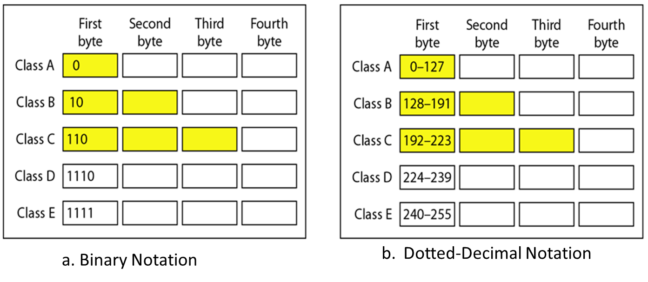
Classful Addressing
IPv4 addressing, used the concept of classes. This architecture is called classful addressing.
In classful addressing, the address space is divided into five classes: A, B, C, D, and E. Each class occupies some part of the address space.

Slide 48
Example
Find class of the following IP addresses?
00000001 00001011 00001011 11101111
11000001 10000011 00011011 11111111
14.23.120.8
252.5.15.111
Solution
  The first bit is 0. This is a class A address.
  The first 2 bits are 1; the third bit is 0. This is a class C address.
  The first byte is 14; the class is A.
  The first byte is 252; the class is E.

Slide 49
Classes and Blocks
One problem with classful addressing is that each class is divided into a fixed number of blocks with each block having a fixed size
Number of Blocks for class A = 2⁷
Number of Blocks for class B = 2¹⁴
Number of Blocks for class C = 2²¹
Block size for class A = 2²⁴
Block size for class B = 2¹⁶
Block size for class C = 2⁸

Slide 50
Cntd…
Previously, when an organization requested a block of addresses, it was granted one in class A, B, or C.
Class A addresses were designed for only large organizations such as the military, government agencies, universities, and large corporations with a large number of attached hosts or routers.
Class B addresses were designed for midsize organizations with tens of thousands of attached hosts or routers.
Class C addresses were designed for small organizations with a small number of attached hosts or routers.
  A block in class A address is too large for almost any organization.
    This means most of the addresses in class A were wasted and were not used.
  A block in class B is also very large, probably too large for many of the organizations that received a class B block.
  A block in class C is probably too small for many organizations.

Slide 51
Network ID and Host ID
In classful addressing, an IP address in class A, B, or C is divided into network ID and host ID.
These parts are of varying lengths, depending on the class of the address.
In class A, 1 byte defines the network ID & 3 bytes define the host ID.
In class B, 2 bytes define the network ID & 2 bytes define the host ID.
In class C, 3 bytes define the network ID & 1 byte defines the host ID.
1st octet
2nd octet
3rd octet
4th octet
Class A
Network
Host
Host
Host
Network
Network
Host
Host
Class C
Network
Network
Network
Host

Slide 52
Default Mask
The length of the network ID and host ID (in bits) is predetermined in classful addressing,
we can also use a mask (also called the default mask), a 32-bit number made of contiguous 1s followed by contiguous 0s.
The mask can help us to find the network ID and the host ID.
For example, the mask for a class A address has eight 1s, which means the first 8 bits of any address in class A define the network ID; the next 24 bits define the host ID.

Slide 53
IP address shortage
In the early days of the Internet, IP addresses were allocated to organizations based on request rather than actual need.
No medium size - Hosts:
  Class A: 16 million
  Class B: 65,536
  Class C: 256
Subnet Mask
The solution to the IP address shortage was thought to be the subnet mask.
Formalized in 1985 , the subnet mask breaks a single class A, B or C network in to smaller pieces.

Slide 54
Address Depletion
The flaws in classful addressing scheme combined with the fast growth of the Internet led to the near depletion of the available addresses.
Yet the number of devices on the Internet is much less than the 2³² address space.
We have run out of class A and B addresses, and a class C block is too small for most midsize organizations.
One solution that has alleviated the problem is the idea of classless addressing.

Slide 55
Subnetting
During the era of classful addressing, subnetting was introduced.
If an organization was granted a large block in class A or B, it could divide the addresses into several contiguous groups and assign each group to smaller networks (called subnets) or, in rare cases, share part of the addresses with neighbors.
Subnetting increases the number of 1s in the mask.
Subnetting is the process of borrowing bits from the HOST bits to network bits , in order to divide the larger network into small subnets.
Subnetting does NOT give you more hosts, but actually costs you hosts.

Slide 56
Cntd…
You lose two host IP Addresses for each subnet, and perhaps one for the subnet IP address and one for the subnet broadcast IP address.
You lose the last subnet and all of it’s hosts’ IP addresses as the broadcast for that subnet is the same as the broadcast for the network.
In older networks, you would have lost the first subnet, as the subnet IP address is the same as the network IP address. (This subnet can be used in most networks.)
Network
Network
Host
Host
172
16
0
0
Network
Network
Subnet
Host

Slide 57
Classless Addressing
To overcome address depletion and give more organizations access to the Internet, classless addressing was designed and implemented.
In this scheme, there are no classes, but the addresses are still granted in blocks.
Address Blocks
  In classless addressing, when an entity, small or large, needs to be connected to the Internet, it is granted a block (range) of addresses.
  The size of the block (the number of addresses) varies based on the nature and size of the entity.
  For example, a household may be given only two addresses; a large organization may be given thousands of addresses.
  An ISP, as the Internet service provider, may be given thousands or hundreds of thousands based on the number of customers it may serve.

Slide 58
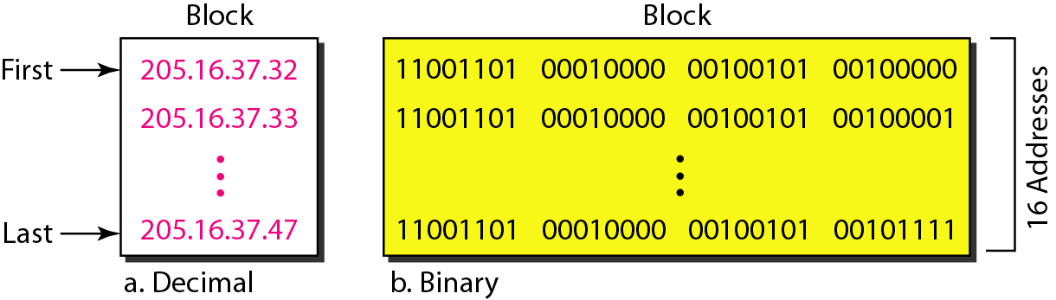
Restriction
To simplify the handling of addresses, the Internet authorities impose three restrictions on classless address blocks:
  The addresses in a block must be contiguous, one after another.
  The number of addresses in a block must be a power of 2 (1, 2, 4, 8 .... ).
  The first address must be evenly divisible by the number of addresses.

Slide 59
cntd…
The above figure shows a block of addresses, in both binary and dotted-decimal notation, granted to a small business that needs 16 addresses.
We can see that the restrictions are applied to this block.
The addresses are contiguous.
The number of addresses is a power of 2 (16 = 2⁴), and the first address is divisible by 16.
The first address, when converted to a decimal number, is 3,440,387,360, which when divided by 16 results in 215,024,210.

Slide 60
Classless addressing Mask
A better way to define a block of addresses is to select any address in the block and the mask.
As we discussed before, a mask is a 32-bit number in which the n leftmost bits are 1s and the 32 - n rightmost bits are 0s.
However, in classless addressing the mask for a block can take any value from 0 to 32.
It is very convenient to give just the value of n preceded by a slash (CIDR – Classless Inter Domain Routing notation).
The address and the /n notation completely define the whole block (the first address, the last address, and the number of addresses).

Slide 61
First address
The first address in the block can be found by setting the 32 - n rightmost bits in the binary notation of the address to 0s.
E.g. 1, A block of addresses is granted to a small organization. We know that one of the addresses is 205.16.37.39/28. What is the first address in the block?
Solution: The binary representation of the given address is
11001101 00010000 00100101 00100111
If we set 32−28 rightmost bits to 0, we get
11001101 00010000 00100101 00100000
or
205.16.37.32.

Slide 62
Last address
The last address in the block can be found by setting the 32 - n rightmost bits in the binary notation of the address to 1s.
E.g., Find the last address for the block in above E.g., 1.
Solution
The binary representation of the given address is
11001101 00010000 00100101 00100111
If we set 32 − 28 rightmost bits to 1, we get
11001101 00010000 00100101 00101111
or
205.16.37.47

Slide 63
Number of Addresses
The number of addresses in the block is the difference between the last and first address.
It can easily be found using the formula 2^{32-n}.
Example
Find the number of addresses in E.g., 1.
Solution
The value of n is 28, which means that number of addresses is 2 ³²⁻²⁸ or 16

Slide 64
Method II
Another way to find the first address, the last address, and the number of addresses is to represent the mask as a 32-bit binary (or 8-digit hexadecimal) number.
  This is particularly useful when we are writing a program to find these pieces of information.
  In the above example the /28 can be represented as:
  11111111 11111111 11111111 11110000 (twenty-eight 1s and four 0s).
Find
  The first address
  The last address
  The number of addresses.

Slide 65
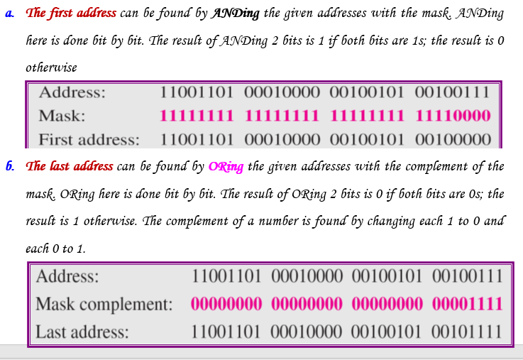
Cntd…

Slide 66
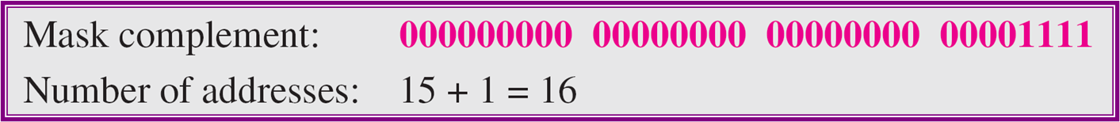
Cntd…
The number of addresses can be found by complementing the mask, interpreting it as a decimal number, and adding 1 to it.

Slide 67
Address Allocation
The next issue in classless addressing is address allocation. How are the blocks allocated?
The ultimate responsibility of address allocation is given to a global authority called the Internet Corporation for Assigned Names and Addresses (ICANN).
However, ICANN does not normally allocate addresses to individual organizations.
It assigns a large block of addresses to an ISP.
Each ISP, in turn, divides its assigned block into smaller sub blocks and grants the sub blocks to its customers.
In other words, an ISP receives one large block to be distributed to its Internet users. This is called address aggregation: many blocks of addresses are aggregated in one block and granted to one ISP.

Slide 68
Example
An ISP is granted a block of addresses starting with 190.100.0.0/16 (65,536 addresses).
The ISP needs to distribute these addresses to three groups of customers as follows:
  The first group has 64 customers; each needs 256 addresses.
  The second group has 128 customers; each needs 128 addresses.
  The third group has 128 customers; each needs 64 addresses.
Q: Design the sub blocks and find out how many addresses are still available after these allocations?

Slide 69
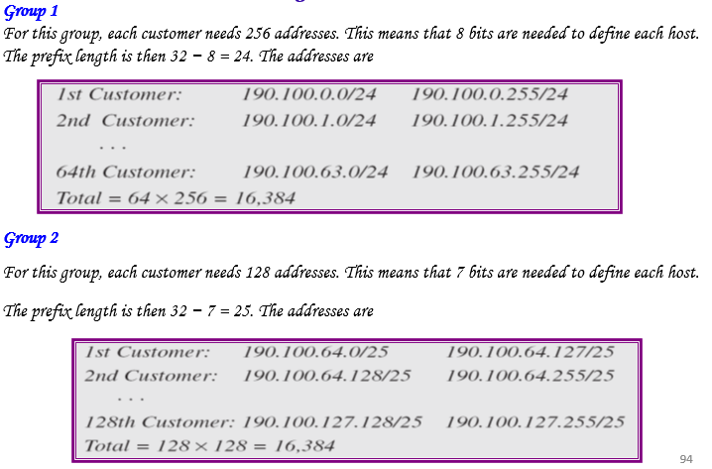
Solution

Slide 70
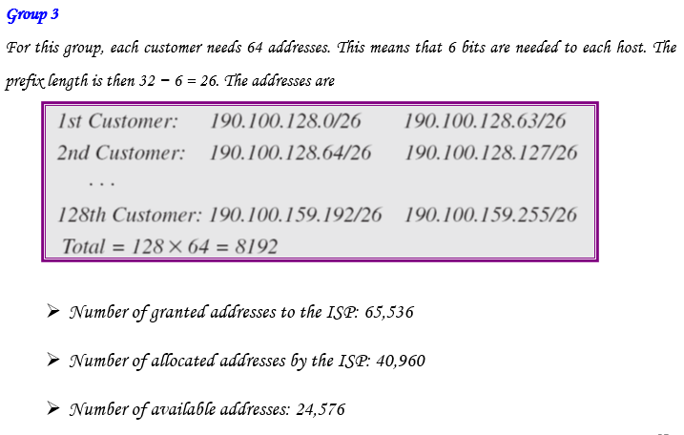
Solution

Slide 71
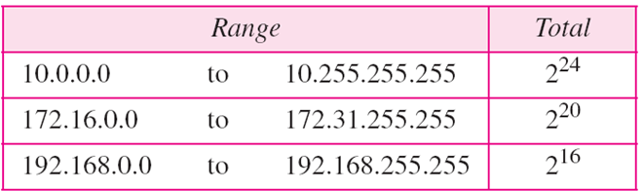
Network Address Translation (NAT)
Many users start to have more hosts to be connected to the internet
IP addresses are in depletion
Solution: NAT
NAT enables a user to have a large set of addresses internally and one address, or a small set of addresses, externally.
The traffic inside can use the large set; the traffic outside, the small set.
Reading Assignment
Read how NAT works, Investigate the global IP address scheme of AMU and how they use it in NAT

Slide 72
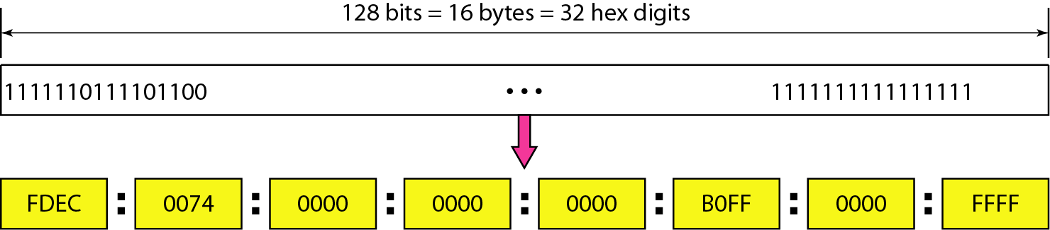
IPv6 Addresses
Internet Protocol (IP) version 4 is the most commonly used communication protocol for both the Internet and internal network environments.
  Although IPv4 is robust and scalable, new technologies and higher demand have paved the way for the eventual adoption of IPv6.
Despite all short-term solutions, address depletion is still a long-term problem for the Internet.
  This and other problems in the IP protocol itself have been the motivation for IPv6.
An IPv6 address is 128 bits or 32 hexadecimal digits long.

Slide 73
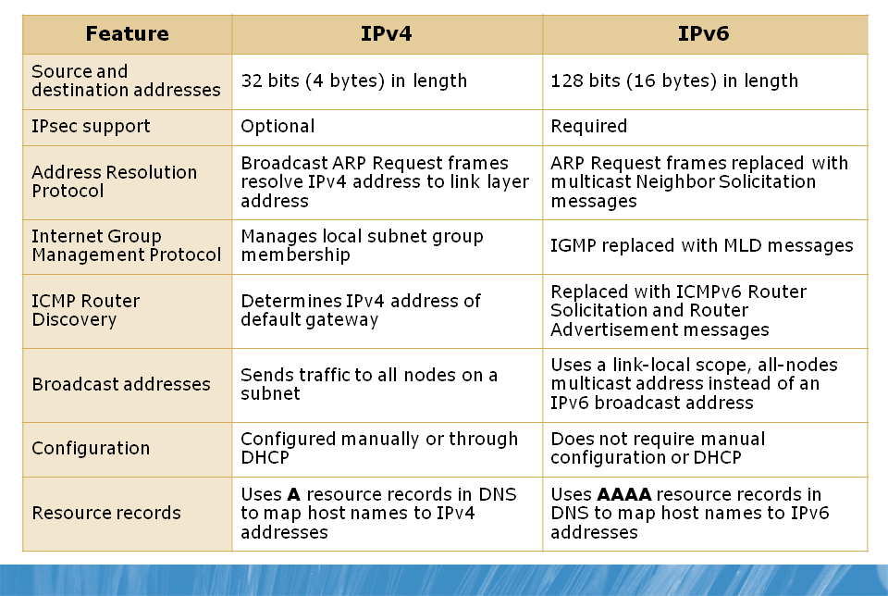
Differences Between IPv4 and IPv6
Notes:
Multicast listener discovery

Slide 74
Advantages of IPv6 Addressing Scheme
Large address space:- IPv6 uses a 128-bit address space, which allows for 3.4x10³⁸ or 340,282,366,920,938,463,463,374,607,431,768,211,456 possible addresses.
Hierarchical addressing and routing infrastructure:- The IPv6 address space is designed to be more efficient for routers, which means that even though there are many more addresses, routers can process data much more efficiently because of address optimization.
Stateless and Stateful address configuration:- Stateless address configuration refers to host IP configuration without a DHCP server.
  Stateful address configuration refers to host IP configuration that uses a DHCP server.
  IPv6 supports both stateless and stateful address configuration.
  With stateless address configuration, hosts automatically configure themselves with IPv6 link-local addresses along with additional addresses advertised by local routers.

Slide 75
Cntd…
Built-in security:- IPv6 has built-in IP security, which facilitates configuration of secure network connections.
Prioritized delivery:- IPv6 contains a field in the packet that allows network devices to determine the specified rate at which the packet should be processed.
  This allows traffic prioritization or QoS. For example, when streaming video traffic, it is critical that the packets arrive in a timely manner. You can set this field to ensure that network devices determine that the packet delivery is time-sensitive.
Neighbor detection:- IPv6 uses the Neighbor Discovery protocol to manage the interaction between nodes within the same network link.
  Neighbor Discovery replaces the broadcast-based Address Resolution Protocol (ARP) with more efficient multicast and unicast communication within the same network segment.
Extensibility:- IPv6 has been designed so that it can be extended with fewer constraints than IPv4.

Slide 76
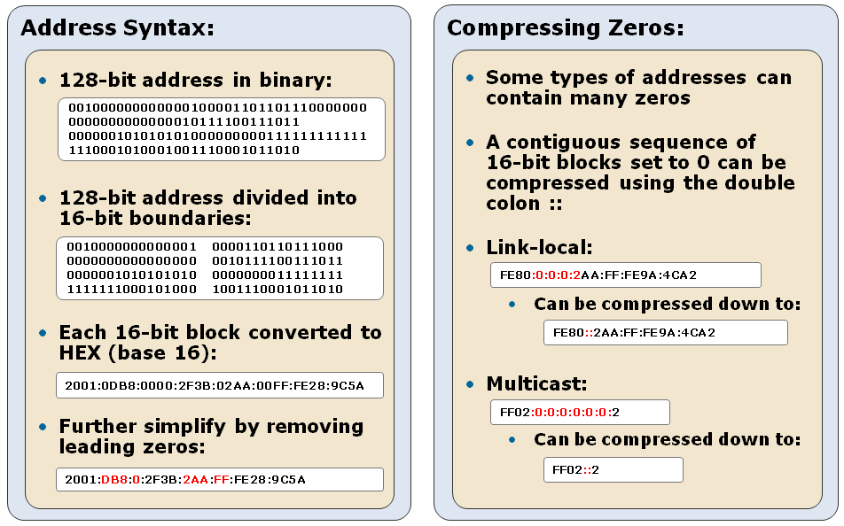
IPv6 Address Space

Slide 77
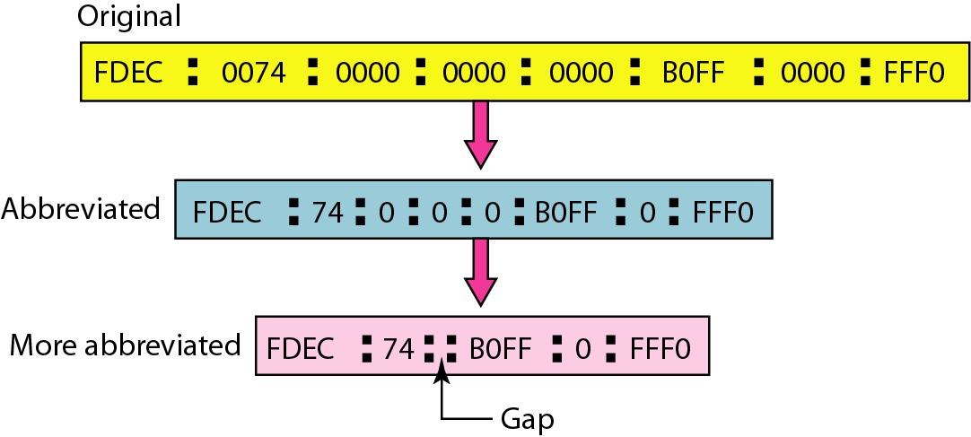
Abbreviated IPv6 addresses

Slide 78
Example
Expand the address 0:15::1:12:1213 to its original.
Solution
We first need to align the left side of the double colon to the left of the original pattern and the right side of the double colon to the right of the original pattern to find how many 0s we need to replace the double colon.
  This means the original address is:

Slide 79
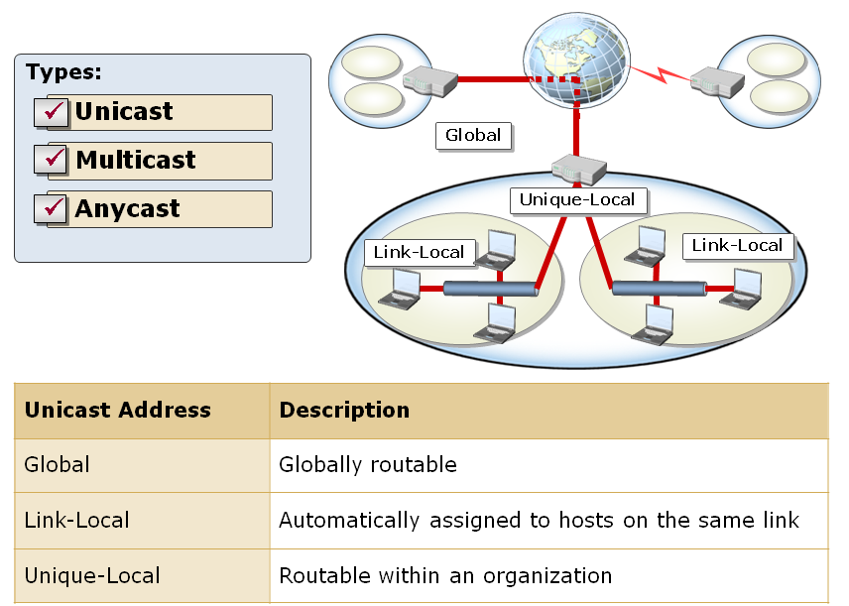
Types of IPv6 Addresses

Slide 80
Cntd…
  There are three main types of IPv6 addresses:
  Unicast:- Identifies a single interface within the address scope.
  Packets that are addressed to this address are delivered to a single interface.
  Multicast:- Identifies multiple interfaces and delivers packets to all interfaces that are identified by the address.
  It is used for one-to-many communication over a network infrastructure.
  Anycast:- Identifies multiple interfaces, but delivers packets to the nearest interface.
  It is used for one-to-many communication, with delivery to a single interface.

Slide 81
  End of Chapter Three
  Any question ???

